Slide 1
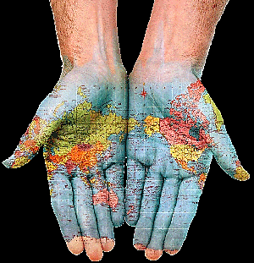
WHAT ARE THE MOST SPOKEN LANGUAGES IN
THE WORLD?
10th grade
Prof. Juliana Pereira
ESCOLA SECUNDÁRIA DE PALMELA

Slide 2
Language | Family | Native | Total | Other estimates | Rank
Mandarin | Sino-Tibetan, Chinese | 845 million (2000) | 1025 million | One of the six official languages of the United Nations. All varieties of Chinese language: 1,200 million (2000) | 1
Spanish (Castilian) | Indo-European, Romance | 329 million (1986–2000) | 390 million | 400 million native. 500 million total (2009) One of the six official languages of the United Nations. | 2
English | Indo-European, Germanic | 328 million (2000–2006) | — | Approximately 375 million L1 speakers, 375 million L2 speakers, and 750 million EFL speakers. Totaling about 1.5 billion speakers. One of the six official languages of the United Nations. | 3
Hindi-Urdu (Hindustani) | Indo-European, Indic | 240 million (1991–1997) | 405 million (1999) | 490 million total. Higher estimates of native speakers, such as the 2000 Indian census, may include other Hindi languages | 4
Arabic | Afro-Asiatic, Semitic | 206 million (1999), 221 million, 232 million (206M is 'all Arabic varieties'; 221M is Arabic 'macrolanguage', not counting Hassaniya; 232M is sum of counts for all dialects) | 452 million (1999) | 280 million native. One of the six official languages of the United Nations. | 5
Bengali | Indo-European, Indic | 181 million (1997–2001) | 250 million |  | 6–7
Portuguese | Indo-European, Romance | 178 million (1998) | 193 million | 220 million native, 240 million total. Ethnologue estimate misses ~12 million in Angola | 6–7
Russian | Indo-European, Slavic | 144 million (2002) | 250 million | One of the six official languages of the United Nations. | 8
Japanese | Japonic | 122 million (1985) | 123 million |  | 9
Punjabi | Indo-European, Indic | 109 million (2000) All varieties: Lahnda, Seraiki, Hindko, Mirpur | — |  | 10

Slide 3
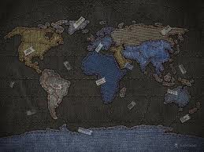
WHERE ARE THESE
LANGUAGES SPOKEN?

Slide 4
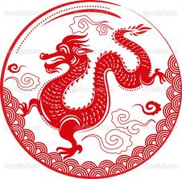
CHINESE

Slide 5
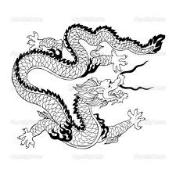
Chinese, Mandarin:
China (using Simplified Han script)
Taiwan (using Traditional Han script; Hokkien is the most spoken language, yet not official)
Singapore (using Simplified Han script; with English, Malay and Tamil)
Chinese, Cantonese:
Parts of China
  Hong Kong (with English)
  Macau (with Portuguese)

Slide 6

SPANISH

Slide 7

Argentina
Bolivia (with Aymara and Quechua)
Chile
Colombia
Costa Rica
Cuba
Dominican Republic
Ecuador
El Salvador
Equatorial Guinea (with French and Portuguese)
Guatemala
Honduras
Mexico
Nicaragua
Panama
Paraguay (with Guaraní)
Peru (with Aymara and Quechua)
Philippines (mainly as Chavacano in Basilan and Zamboanga Peninsula)
Puerto Rico (with English)
Spain (Aranese, Basque, Catalan, and Galician are co-official in some regions)
Uruguay
Venezuela

Slide 8
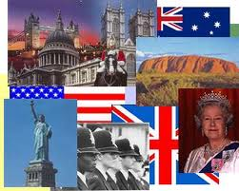
English
http://en.wikipedia.org/wiki/List_of_countries_where_English_is_an_official_language

Slide 9
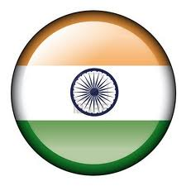
HINDI-URDU – HINDUSTANI

Slide 10
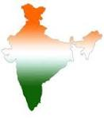
Hindi :
India (with 22 other official languages)
Fiji (with English and Bau Fijian)
Urdu:
India (with 22 other official languages)
  Jammu and Kashmir
  Delhi Territory
  Uttar Pradesh state
  Bihar state
  Andhra Pradesh mainly in Hyderabad (former princely state of Nizam) and adjacent areas of Maharashtra and Karnataka
Pakistan (with English, Pothowari, Punjabi, Kashmiri (Koshur), Pashto, Sindhi, Siraiki, Balochi and Brahui)
Fiji (with English and Bau Fijian; known constitutionally as Hindustani as an umbrella term to cover Urdu, as well as Hindi.)

Slide 11

ARABIC

Slide 12
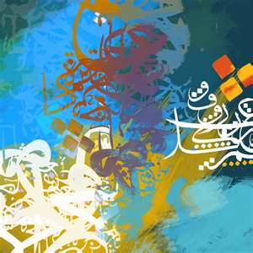
Algeria
Bahrain
Chad (with French)
Comoros (with French and Comorian)
Djibouti (with French)
Egypt
Eritrea (with Tigrinya)
Iraq (with Kurdish and Assyrian/Syriac)
Israel (with Hebrew)
Jordan
Kuwait
Lebanon
Libya
Mauritania
Morocco
Oman
Qatar
Saudi Arabia
Somalia (with Somali)
Sudan (with English)
Syria
Tunisia
United Arab Emirates
Yemen

Slide 13
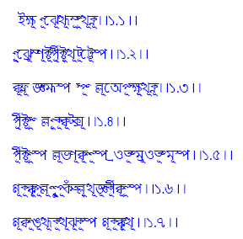
BENGALI

Slide 14

Bangladesh
India (with Hindi, English {as a "subsidiary official language"} and 20 other official languages; second most spoken Indian Language)
  Andaman and Nicobar Islands
  Assam
  Tripura
  West Bengal

Slide 15

PORTUGUESE

Slide 16
Angola
Brazil
Cape Verde
East Timor (with Tetum)
Guinea-Bissau
part of the People's Republic of China
  Macau (with Chinese)
Mozambique
Portugal
São Tomé and Príncipe

Slide 17

RUSSIAN

Slide 18
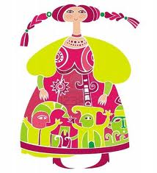
Russia (in some regions together with regional languages)
Abkhazia (with Abkhaz - independence disputed)
Belarus (with Belarusian)
Kazakhstan (with Kazakh)
Kyrgyzstan (with Kyrgyz)
Moldova (with Moldovan, Ukrainian and Gagauz)
South Ossetia (with Ossetian and Georgian - independence disputed)
Tajikistan (with Tajik)

Slide 19

JAPANESE

Slide 20
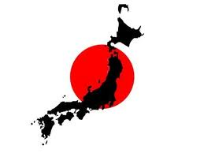
Japan
Part of Palau
  Angaur (with English)

Slide 21
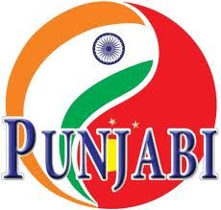
PUNJABI

Slide 22
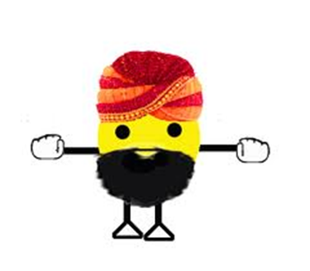
Pakistan (with English, Pothowari, Urdu, Kashmiri (Koshur), Pashto, Sindhi, Siraiki, Balochi and Brahui)
India (with 22 other official languages)
  Punjab
  Delhi

Slide 23
Referências bibliográficas electrónicas: http://en.wikipedia.org/wiki/List_of_languages_by_number_of_native_speakers

